Slide 1
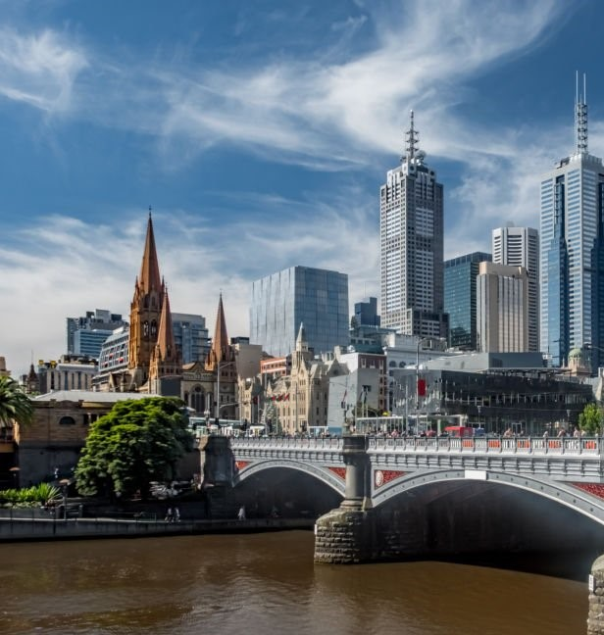
City of Melbourne’s Pedestrian Analysis
Name: Eric Chow

Slide 2
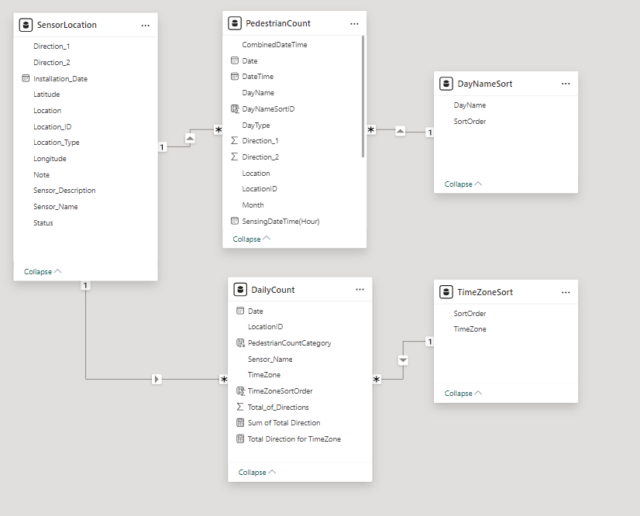
Data Source and Data Model
SensorLocation Table:
Contains metadata about each sensor, including location coordinates (latitude, longitude), sensor description, and installation date.
Key fields: Location_ID, Latitude, Longitude, Sensor_Description.
PedestrianCount Table:
Holds the pedestrian count data aggregated by date and time, with fields for both hourly and daily counts.
Key fields: Total of Direction, Date, Time, Location_ID.
Uses power query to add custom columns to perform data transformation, data merging and conditional columns.
DailyCount Table:
Aggregates daily pedestrian counts by location and time zone, providing a summary view of the pedestrian activity.
Key fields: Date, Location_ID, Total_of_Directions, TimeZone.
DayNameSort and TimeZoneSort Tables:
DayNameSort: Used to sort days of the week correctly (e.g., Monday, Tuesday, etc.).
TimeZoneSort: Ensures time zones (e.g., Morning, Afternoon, Evening, Night) are sorted logically for analysis.
These tables are essential for maintaining the correct order in visualizations and reports.
Key Relationships:
Location_ID in the SensorLocation table is linked to Location_ID in the PedestrianCount and DailyCount tables, ensuring the data is correctly mapped to the sensor locations.
The DayNameSort and TimeZoneSort tables are connected to provide sorted categorical data for days of the week and time zones, enhancing the accuracy of chronological and categorical analyses.

Slide 3
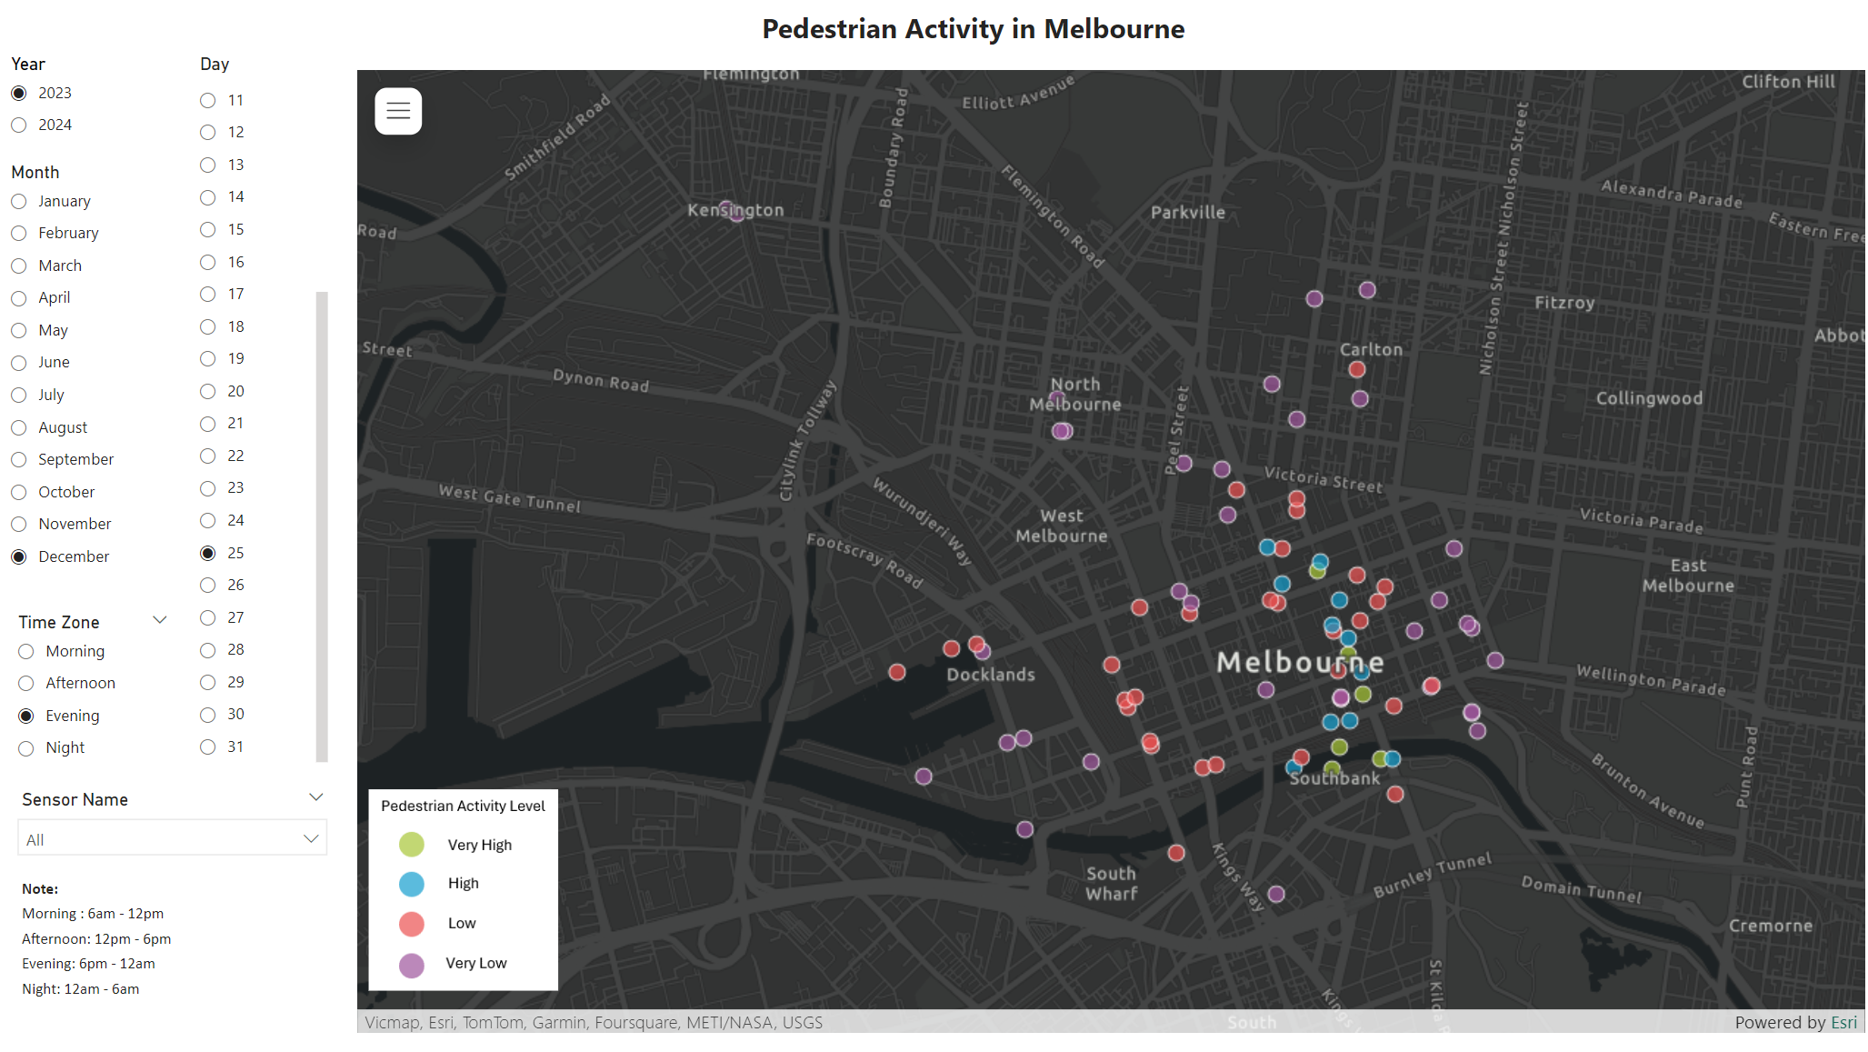
Pedestrian Activity in Melbourne
This slide provides a comprehensive overview of pedestrian activity in Melbourne using an interactive geographic heatmap. The various filters and categorizations enhance the user's ability to explore and analyze pedestrian traffic patterns across different times and locations.
Map Interactivity: The map is interactive but currently locked to focus on the central CBD of Melbourne. This ensures that the most relevant and high-traffic areas are highlighted for analysis.
Geographic Heatmap:
High-traffic Areas: The map shows central Melbourne, particularly around Docklands and Southbank, as areas with very high pedestrian activity, indicated by green markers.
Moderate to Low Activity: Areas with moderate pedestrian traffic are shown in blue and purple, while locations with low pedestrian activity are marked in red.
Suggested Use Case:
1. Event Planning and Management:
Purpose: Aid event organizers in selecting optimal locations for events based on pedestrian traffic data.
Example: Organizers of public events such as festivals, markets, or parades can use the map to identify areas with high visibility and accessibility for maximum attendance.
2. Urban Planning and Development:
Purpose: Assist city planners in understanding pedestrian traffic patterns to make informed decisions about infrastructure development.
Example: Identifying high-traffic areas that may require additional pedestrian crossings, footpaths, or public amenities such as benches, etc.
2. Traffic Flow Management
Purpose: Aid traffic management authorities in understanding pedestrian flow to improve traffic control measures.
Example: Implementing pedestrian signals or adjusting traffic light timings in areas with heavy pedestrian traffic to enhance safety and reduce congestion.

Slide 4
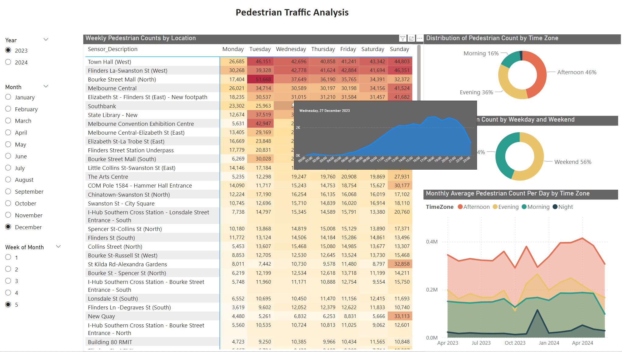
Pedestrian Traffic Analysis
This slide presents a comprehensive analysis of pedestrian traffic across Melbourne, utilizing multiple visualizations to provide insights into patterns and trends.
Hypothesis for Pedestrian Traffic during Dec 25th to 31st 2023
Weekly Pedestrian Counts by Location:
Observation: High pedestrian counts at key locations such as Bourke Street Mall (North) and Town Hall (West) during this period.
Hypothesis: The increased pedestrian traffic at these locations can be attributed to holiday shopping, Christmas events, and New Year's Eve celebrations. These areas are major retail and event hubs, drawing large crowds during the festive season.
Distribution of Pedestrian Count by Time Zone:
Observation: The pie chart indicates a higher pedestrian count in the afternoon (46%) and evening (36%) time zones.
Hypothesis: During the holiday week, afternoons and evenings are peak times for shopping, dining, and socializing. People are likely to engage in festive activities, attend events, and dine out more frequently during these times.
Pedestrian Count by Weekday and Weekend:
Observation: The pie chart shows a higher pedestrian count on weekends (56%) compared to weekdays (44%).
Hypothesis: The weekends during the holiday season, including Christmas Eve, Christmas Day, and the days leading up to New Year's Eve, see increased foot traffic due to events, last-minute shopping, and social gatherings. Weekdays, although still busy, have comparatively lower counts as people may spend more time preparing for the holidays or traveling.
Monthly Average Pedestrian Count Per Day by Time Zone:
Observation: The line chart shows noticeable spike in pedestrian counts in the afternoon and evening time zones around the end of December.
Hypothesis: The spike around late December is likely due to the combined effect of Christmas shopping and New Year's Eve preparations. The trend shows that people are more active in the afternoons and evenings, participating in holiday activities and celebrations. The dip in the morning counts suggests that many people are on annual leave, leading to fewer activities and less movement during the morning hours as people tend to start their day later during the holiday season.

